Slide 1
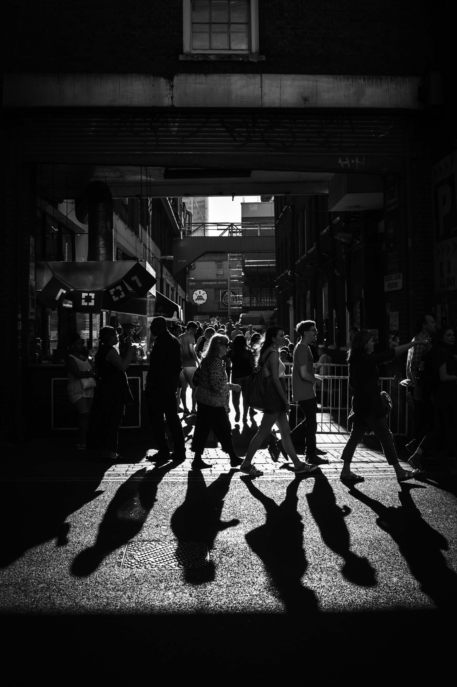

Habits, communication and documentation
Coding in Public workshop
2024
Copyright © 2021. Created by Computational Social Science Training Team, UK Data Service.

Slide 2
Table of Contents
Brains and Getting Things Done
Collaboration and communication
Documentation must match the purpose
When to stop
Questions?
Breakout #2

Slide 3
Brains and Getting Things Done
Notes:
I want to start at the beginning. Brains.

Slide 4
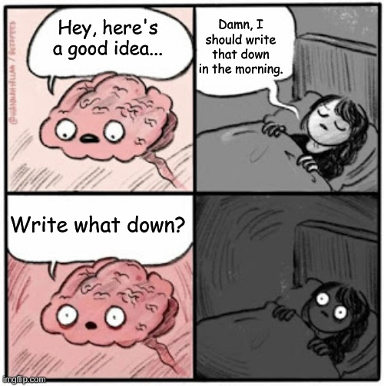
Brains: good for having ideas, not keeping ideas
Notes:
At least not modern and/or literate brains. (Huettig, Kolinsky & Lachmann, 2018; Demoulin & Kolinsky, 2016)
So, I used a process called GTD, which stands for Get Things Done. The original version has 5 steps but I have split the same basic stuff into six steps.

Slide 5
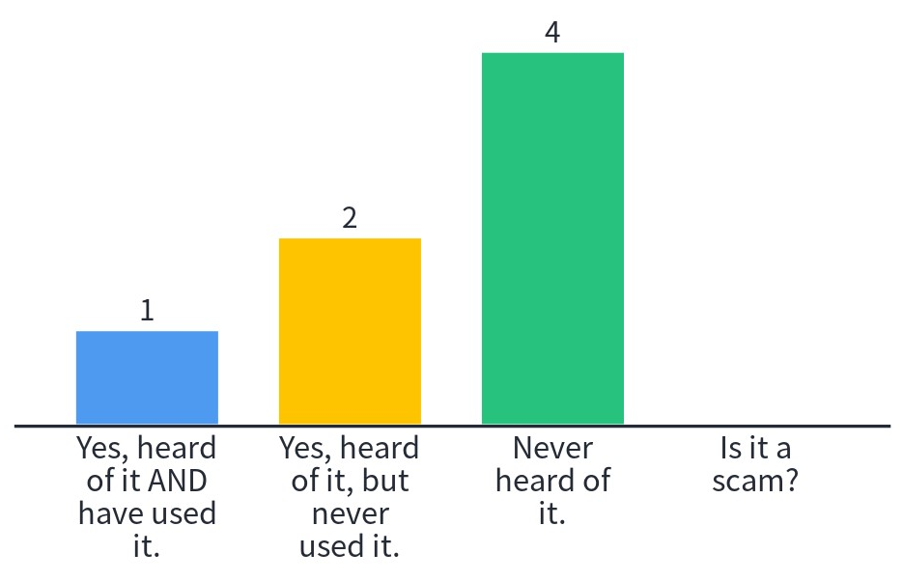
Have you heard of GTD?

Slide 6
1 - Capture
Things your read/watch/listen to that you might want to refer to later
Tweets/hashtags that seem useful
People you meet that you might want to talk to/collaborate with/etc.
Ideas you have
Questions you want to answer
Emails/chat messages/etc. where you discuss or ask things
Et cetera
DO NOT:
assume you’ll remember
evaluate its worth in the moment
get embarrassed about capturing this thing

Slide 7
1- Capture tools
Notebook by the bed
Browser extension
Camera + cloud
Phone apps
Dictaphone/smart board/tablet/QR notebook/etc.
To-do lists
Brainstorm/mind-mapping tools
Meeting recordings/auto-notes
Other
Notes:
Lots of useful apps that turn handwriting into text, that turn speech into text, AI assistants that you can ask to take a note or remind you of a thing, etc.

Slide 8
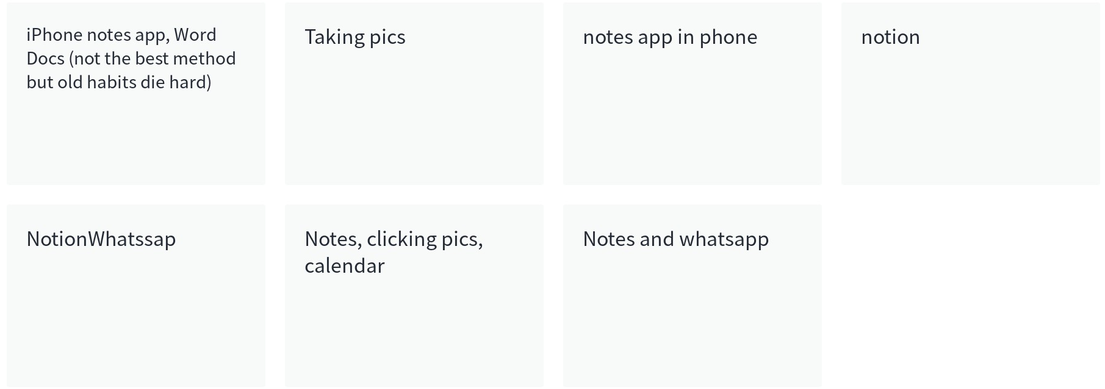
What tools have you used/heard of?

Slide 9
2 - Combine
Schedule time to regularly combine your various sources
Automate combining sources if possible
Good processes for combining any remaining manual tasks
Always look for better processes

Slide 10





3 - Sort
review the captured/combined
(or let others review it)
Mark, RELABEL, MOVE or OTHERWISE PROMOTE THE GOOD STUFF
Move the rest to a searchable archive
Move it forward in the process
Repeat regurlarly

Slide 11
3 - Sort honestly
Schedule regular sorting time.
Read everything in your central place and ask yourself:
Do you understand it? If no, delete it.
If yes, ask yourself: Will you use it in the next 6 months?
If no, archive it (searchable, not binned, low effort)
If yes, sort it by
* Moving it to other places/folders/apps/etc.
* Tag/label/rename
* Link to other things (as appropriate)

Slide 12
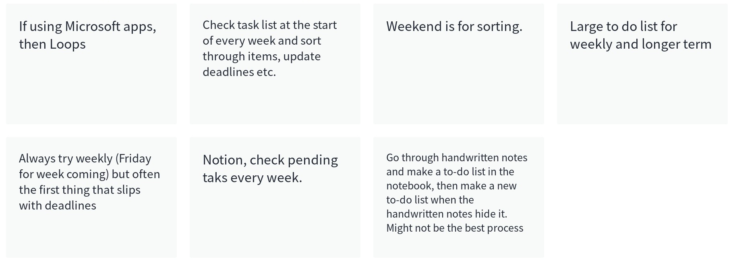
Talk about your combine and/or sort processes

Slide 13
Refine turns vague into actionable
Questions to ask
Clarifying hypotheses
Steps to take
Things that need to be learned/researched
Resources to use
People to talk to/get onboard
Etc.
Notes:
Refine can be seen as part of sort, but you may treat it as a separate step if that works better for you.
Refine is about turning vague hand-waving, late night items into actual projects ideas and tasks by breaking them down into steps, ordering those steps, identifying what part of those steps needs to be done first or needs something else to be completed first, etc.

Slide 14
4 – Action
If you can do it quickly (less than 2 minutes), just do it.
If you can do it but not quickly, then schedule it to be done.
If cannot do it without another thing, schedule both the things.
Notes:
Put it into calendars or to-do lists, Kanban boards, etc.
Keep those records.

Slide 15
4 – Action and/or schedule
If you can do it quickly (less than 2 minutes), just do it.
If you can do it but not quickly, then schedule it to be done.
If cannot do it without another thing, schedule both the things.
SCHEDULING IS AN ACTION
What are the priority actions (necessary to do)
What are the urgent actions (need to be done first)
Who is doing what?
When are they being done?
Who or what is dependent on who/what?
Who is a resource if things go wrong?
Notes:
Put it into calendars or to-do lists, Kanban boards, etc.
Keep those records.
The trick is to actually action the actions, do the scheduled things. Don’t procrastinate.
If you find yourself procrastinating, don’t get mad at yourself. Consider it an opportunity to reflect on your process. Why are you procrastinating? Do you need something? Need to break it down more? Need to do something else first? Need help? Need better tools?

Slide 16
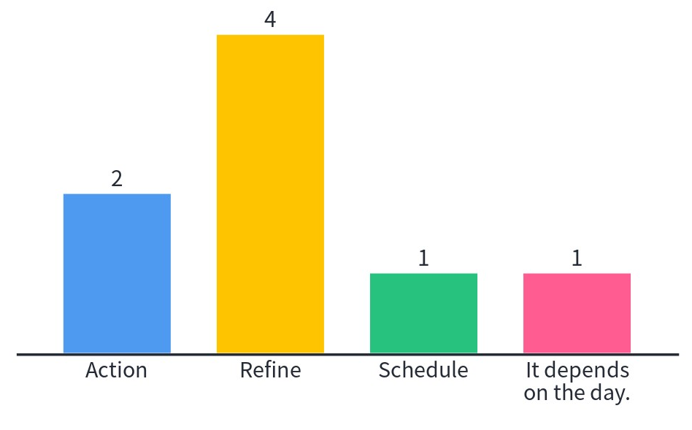
Which do you think is harder to do?

Slide 17
5 - Reflect
What is working/not working at each step?
What are you proud of?
Do you need to do things differently? Action or schedule these
Write the reflections down.
Discuss them with people when you can.
Reflect on the written reflections occasionally.

Slide 18
The steps are not always totally separate
Collaborative work often is capture + combine + sort
Writing the agenda and minutes are part of this
Checking the minutes/agreeing the action items is too
May need explicit follow ups to reflect on brainstorm outputs
Put everything in a central, accessible place
Make it easy for others (e.g. put a link to the doc in an email, mark the things you want them to check with their initials/in colour/etc.)
Put sessions in comms plan/calendars/to-do lists/Trello boards/etc.
Notes:
We discuss collaboration more later so don’t worry too much just now.

Slide 19
Doesn’t that take a lot of time?
Not as much as you think.
It gets easier/faster with practice.
If you protect this time in your calendar, others will respect it.
This time is an investment in you.
This time/effort saves a lot of panicked scramble later (where was that quote from?!?, etc.)
You will know yourself better (is today a sort day or a refine day? A schedule day or a do day?) and act appropriately.

Slide 20
Incentives
Attach new habits to existing habits
Get help from others
Pomodoro technique – 4 X 25 focus minutes + 5 break minutes
Reward yourself for any steps done, tasks done, or pomodoros
Alternate different kinds of tasks – creative tasks, detail tasks, menial tasks, physical tasks, etc.
Consider your strengths, motivations and incentives when scheduling
Notes:
You will get a lot of info on your incentives from the reflection phase of GTD.
Maybe your reflection shows you are not a morning person? Maybe that you do your best coding when you are in the office?
Maybe that you tend to procrastinate if you get stuck and so need to consider ways to reduce getting stuck (like scheduled catch ups, group work days, etc.)

Slide 21
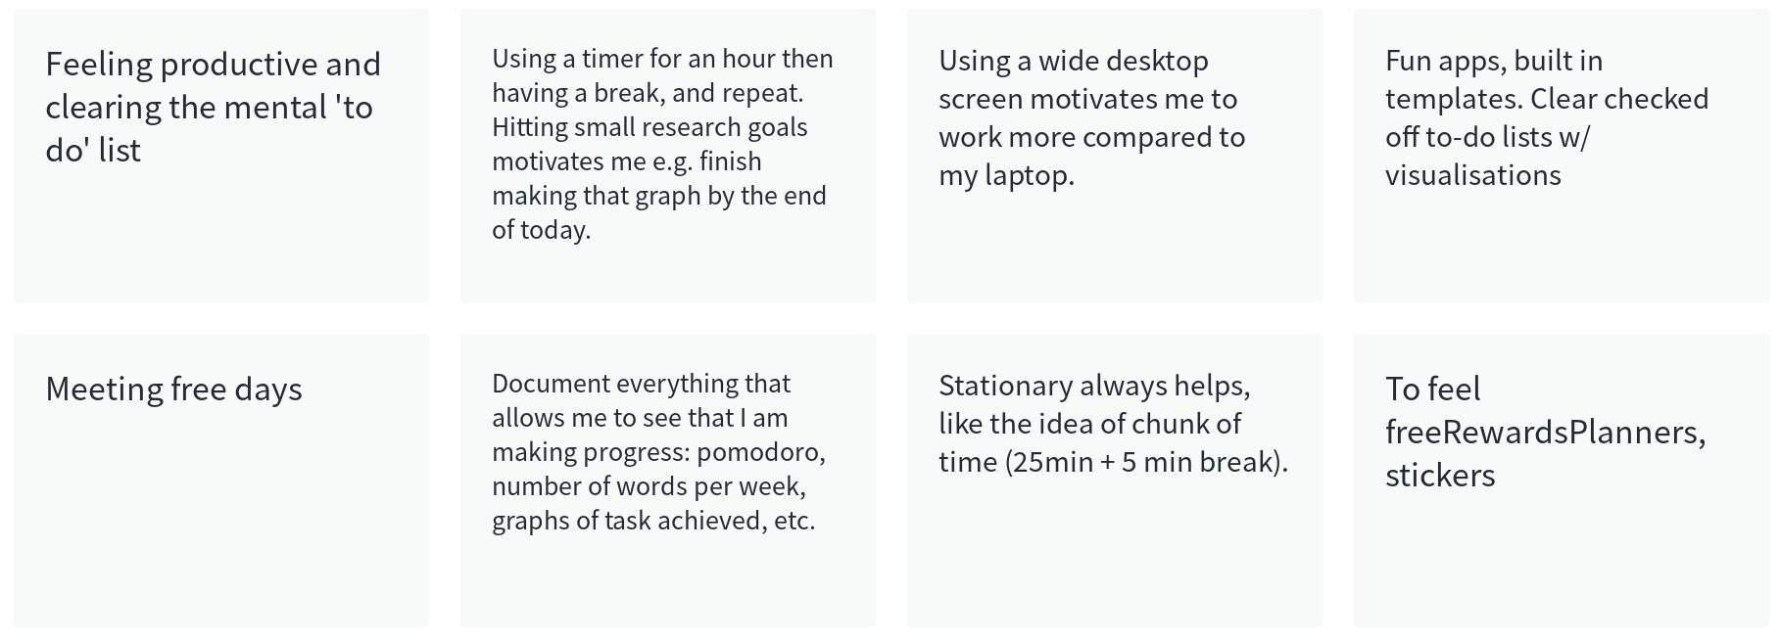
What motivates or incentivises you?

Slide 22
Collaboration and communication
Notes:
There is a huge link between collaboration and communication and reproducibility.
Remember that good reproducibility means communicating and collaborating:
With others in your team now
With yourself in the future
With others (not in your team?) in the future

Slide 23
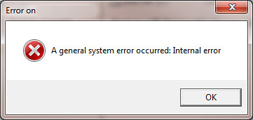
Collaboration and communication blocks reproducible if:
Things are not equally accessible
Processes are not clear/documented
Teams/people are siloed
Decisions are not discussed, justified or documented
Credit or contribution is not agreed or documented
Timelines are not documented
This Photo by Unknown Author is licensed under CC BY-SA
Notes:
Have written comms plan, meeting agenda, meeting minutes, strategy docs, etc.
Clarify documentation expectations/set good examples
Schedule time to document
Reflect on how often you document/how much time you spend documenting

Slide 24
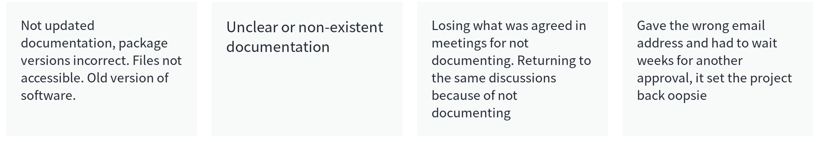
Which of these has frustrated you in the past?

Slide 25
Assume nothing
Language
Terminology
Platforms
Requirements
Traditions
Habits
Naming conventions
Storage locations
Track changes?
Etc.
Notes:
Don’t assume – ask questions, listen to the replies, come to an agreement

Slide 26
Distribute, designate, delegate
Distribute – divide work to all according to individual skills/responsibility/time
Designate – Clarify the priority and urgency of each task
Delegate – Trust the trustworthy to represent you
Notes:
Distribute fairly (not all the rubbish tasks for the historically marginalised) with appropriate opportunities for growth
Give support and/or examples to follow, with opportunities for feedback
Designate - Priority is about how necessary a task is for overall success, urgency is about first deadlines
Be aware of tracking progress, opportunities for feedback (if something is not understood the deadline will be missed)
Delegate – Don’t hover or abandon, but match checking in to individual style, with clear 2 way communication

Slide 27

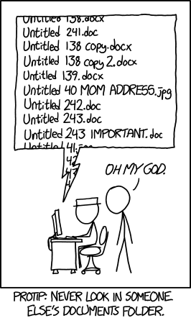
Use good tools
Notes:
This is just a relatable example of how not agreeing things like naming conventions, or good shared locations, leads to problems.
These problems can be (at least partially) solved with good tools.

Slide 28
Reflect! Processes are never done
Consider the legacy
Sometimes things blow up unexpectedly (and much later)
Take time to reflect on what was done/how/when/etc.
Maintain contact with collaborators (if possible) to make it easier to reflect collaboratively
Share what went well on the project as well as what went well in the process
Notes:
For example, you may find yourself leading a workshop on how to get researchers to improve their reproducibility and want to show how documentation and collaboration can make that better or worse.

Slide 29
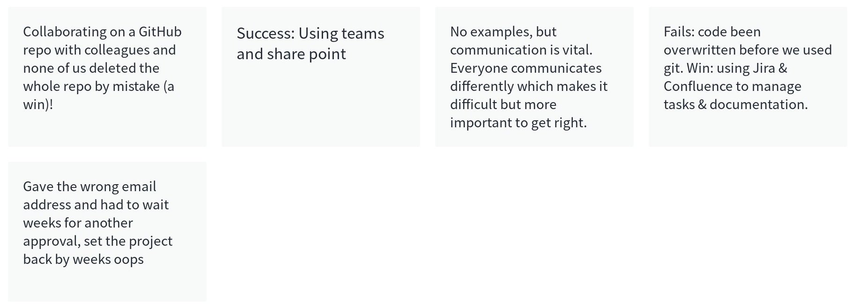
Share some collab/comms wins and/or fails
Notes:
Short answer/discussion about how their experiences.

Slide 30
Documentation must match purpose
Notes:
Do we need a 5 minute break?
Documentation is almost always better than no documentation
But what the documentation is used for is relevant
The lists of ideas you had in the middle of the night should not be treated the same as minutes of formal project meetings
The git log of your project is not referenced in the same way as your software version
Et cetera

Slide 31
Documentation by you, for you
Lots of your documentation may never be used/seen by others
It is still useful to document because:
Can relieve your mind (out of my head, into my lists)
Create an evidence trail should there ever be some kind of formal complaint (always document things along this line)
Reassuring when you feel you’ve “done nothing”
Are useful to peruse when you go to brush up your CV
Lots of other reasons that may be quite personal

Slide 32
For you, by you
Spend less time on how it looks, more time on how it works
It is important that you feel it is easy (or pleasant?) to use this documentation system for your own benefit
Make sure you know how to get things out of it safely if needed
Make a legacy plan for it
Notes:
You can tell others about your system (or share it) if useful (e.g. if you find yourself mentoring a junior colleague or leading a workshop on reproducibility)

Slide 33
Documentation to stay in-team
Lots of documentation is only seen/used briefly by your direct team
That doesn’t mean they are not useful to document because:
Necessary step to moving ideas forward to tangible products
Track credit/contribution for ideas to appropriate people/teams
Resource for sense check (especially after a holiday…)
Capture discussions that may turn into future work
Et cetera

Slide 34
Stay in-team
Locations, conventions and responsibilities agreed
Spend more time checking it is readable, works for everyone, that everyone is participating
Make sure everyone knows what can and cannot be shared outside of the team if needed
Needs a legacy plan to ensure everything works if key players leave or after project is done
Notes:
More on this in the collaboration and communication section

Slide 35
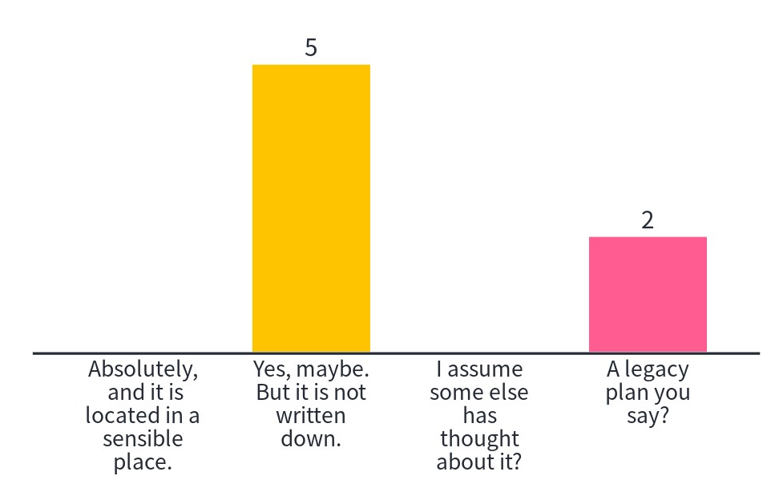
Does your project have a legacy plan?

Slide 36
Documentation to share with the higher ups
Fewer things will seen/used with formal structures
Ethics applications, funding bids, job extension requests, etc.
You need to keep these as well as the supporting documentation that produced them:
Things in formal documentation are not always as they appear
Formal requirements for you can mean formal support/approval too!
Et cetera

Slide 37
Share with the higher ups
Probably comes with specific forms, criteria, deadlines
Always keep copies for yourself
Ensure you are getting what you are owed as well as doing what you are required to do (formal agreements are always two-way streets)
Maybe share more widely with/without anonymisation?
Notes:
Share widely examples such as funding bids, promotion applications, etc.

Slide 38
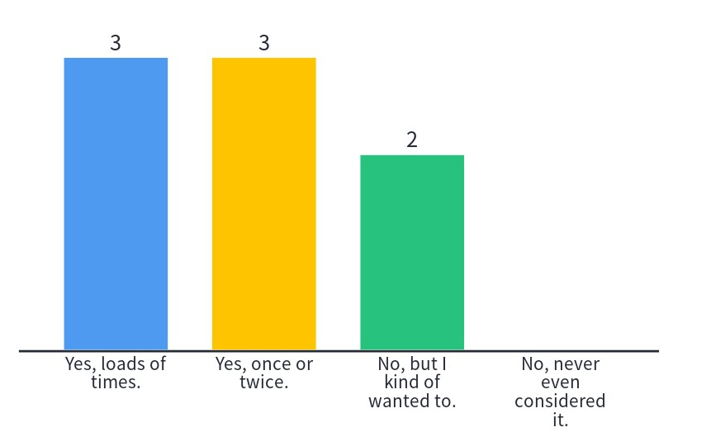
Have you ever requested a formal document from a colleague as an example?

Slide 39
Documentation to share with other researchers
Put it where everyone can see your article/chapter/output
Final stage and working stages are different
Legacy plan here too
Not everyone will want to examine your code/data
But you should still document as if they would:
As much end-to-end process as possible
As much data/code/analysis/other as possible
No one has ever told me my code was ugly
A couple of really techy people were genuinely amazed that I published my entire research project in an interactive notebook.
Don’t be embarrassed.

Slide 40
How to tell what kind of documentation it is?
Is it necessary to reproduce the work exactly ?
Is it helpful to reproduce the work in any way?
Are there any restrictions against sharing it?
Will it be useful to support you in some kind of claim/dispute?
Is it a massive hassle to make it suitable for public consumption?
Will it hurt you to share it?

Slide 41
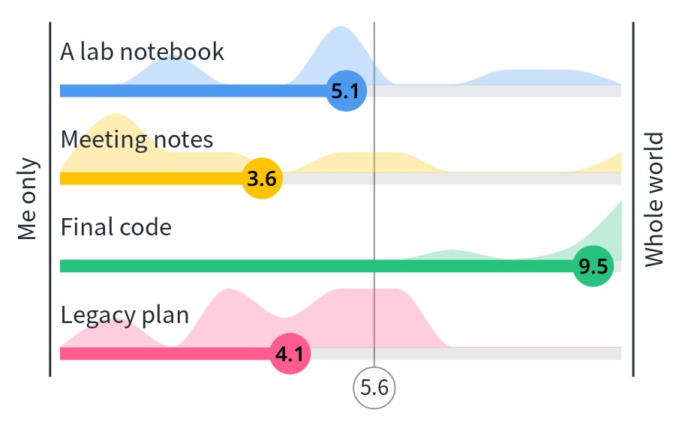
What level of sharing is right for this? 1

Slide 42
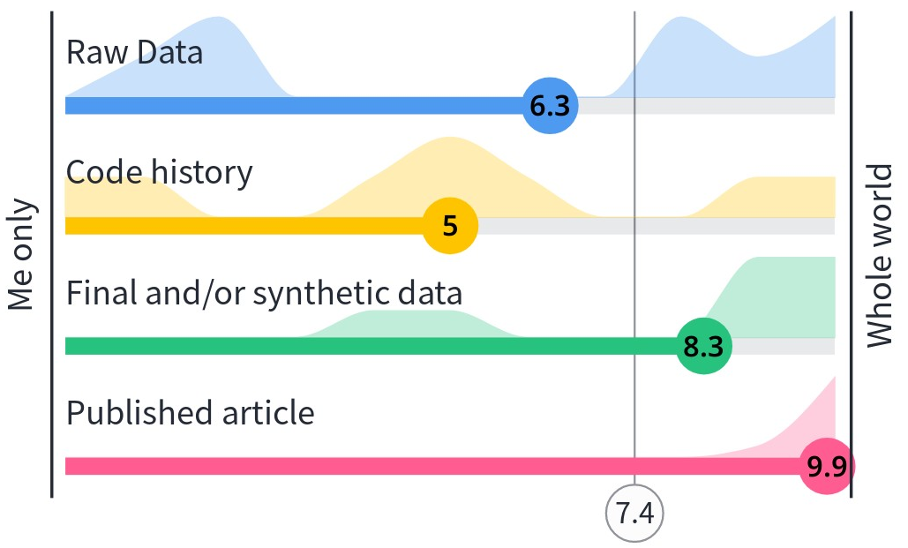
What level of sharing is right for this? 2

Slide 43
When to stop

Slide 44
Keep everything that you can keep
Ideas, agenda, minutes, brainstorming, sources, code environments, etc.
To document the process, work, decisions, actions, etc.
More effort while creating/using them = more useful later
Anonymize or store securely if needed

Slide 45
When to stop documenting
Do not document/share anything that you do not have a right to document/share
E.G. ask to record interviews, ask if people are happy to be listed as corresponding author, etc.

Slide 46
Also, stop documenting when…
You are spending more time on the documentation than on the actual work.
If you find the documentation to workflow balance is off, try:
Automating the boring stuff
Using better tools/processes
Scaling back/rescoping the project
Recruiting help for sanity checks
Other suggestions?
Notes:
This should be come clear in the reflection stage of the GTD process, but maybe also in feedback from colleagues, etc.

Slide 47
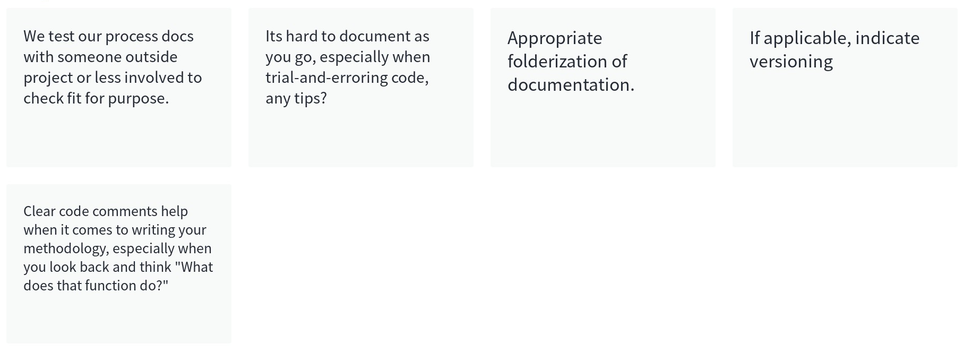
Any more ideas about documentation?

Slide 48
References
Falk Huettig, Régine Kolinsky & Thomas Lachmann (2018) The culturally coopted brain: how literacy affects the human mind, Language, Cognition and Neuroscience, 33:3, 275-277, https://doi.org/10.1080/23273798.2018.1425803
Demoulin, C., Kolinsky, R. Does learning to read shape verbal working memory?. Psychon Bull Rev 23, 703–722 (2016). https://doi.org/10.3758/s13423-015-0956-7
Wikipedia community. (2022). "Getting Things Done." Retrieved 21/03/2022, from https://en.wikipedia.org/wiki/Getting_Things_Done.
Wikipedia community. (2022). “Pomodoro Technique.” Retrieved 02/05/202, from https://en.wikipedia.org/wiki/Pomodoro_Technique.

Slide 49
Q&A

Slide 50
Breakout #2
Notes:
How are myths around “having good ideas and remembering good ideas” hurtful to some researchers? E.g. do some people get imposter syndrome more if they “Think they should be able to remember everything”
How are incentives, strengths and motivations less flexible or individual that they could be? How is that exclusive toward some researchers?
How are the burdens of documenting distributed inequitably? Who loses out? What can be done?
Why might some researchers (sometimes) find it hard to document the way they want?
Collaboration and communication – whose responsibility is it to ensure communication works well? Who ends up doing the work? Who feels left out? There is scope for decolonising the language research projects use, but if this is not already a topic how can researchers introduce it?
When to stop? Have you ever done more on documentation than on non-documentation? Or do you view documentation as “non-work”?
Create and/or sign into a github account. Share your name with your breakout group.

